Slide 1
GUI-RITS(ver1.4.0) Edge user manual 09/25/2023

Slide 2
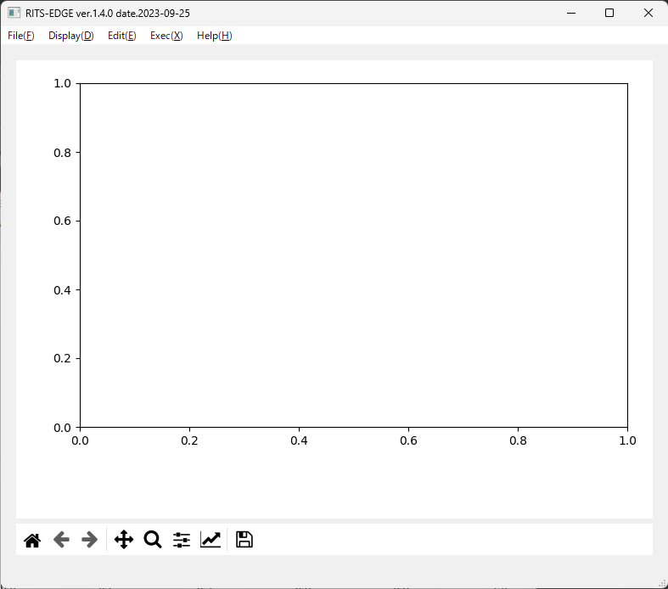
When GUI-RITS is launched in Windows, two windows like this one will appear unless you customize it.
In this manual, the lower left window is called the “terminal” and the upper right window is called the “main screen”.
The terminal has no control functions. It can be ‘hidden’ if it gets in the way. (Do not ‘close’.)
Main screen
Terminal

Slide 3
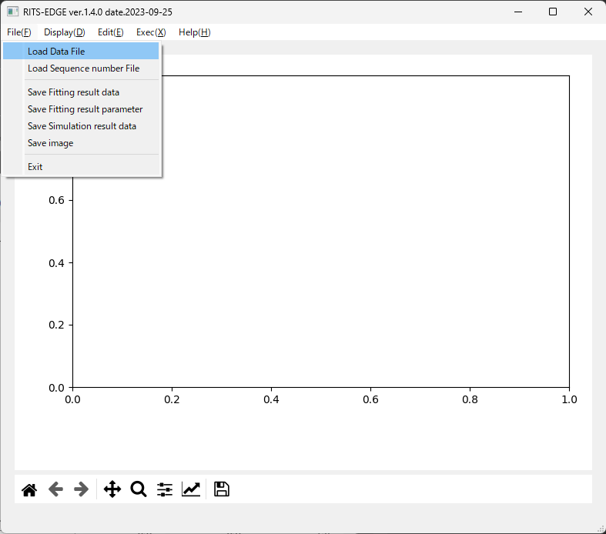
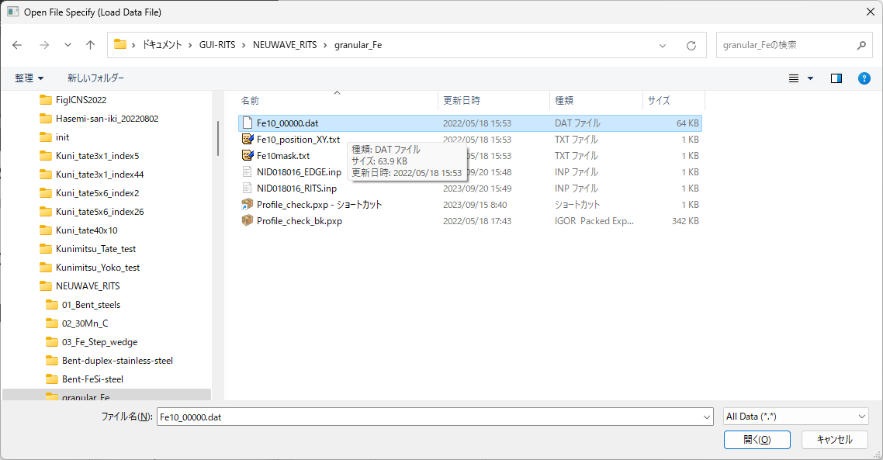
As a start, let's load a transmission data of the standard iron sample and determine the instrument parameters (L1, α, β, and σ) for the experiment.
Select "Load Data File" from the File menu.
The Windows Explorer screen will appear, and select the data file of the standard iron sample (in this example, Fe10_00000.dat).

Slide 4
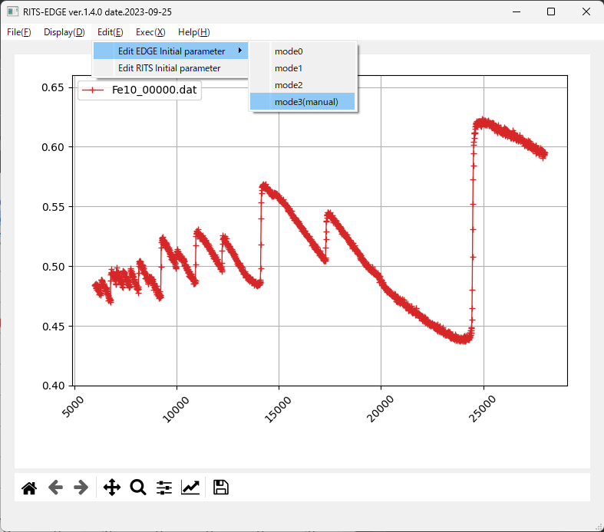
After loading the data file for the standard iron sample, the spectrum is displayed as shown in the main screen. The horizontal axis is tof (μs) and the vertical axis is transmittance.
The explanation of the Display(D) menu is omitted.
Next, select mode3 (manual) from the Edit menu.
The explanation of mode0~2 is omitted here.

Slide 5
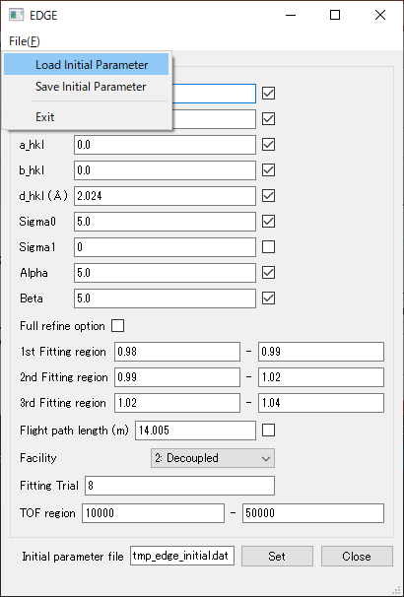
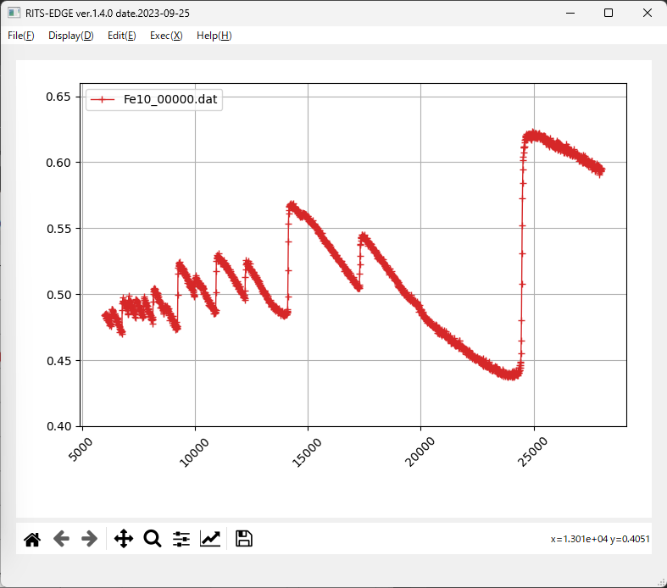
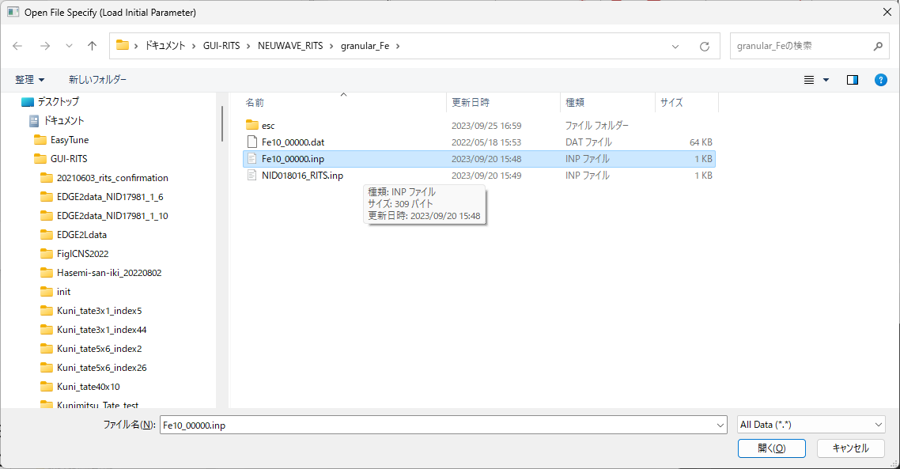
initial value
refinement flag
By selecting "Load Initial Parameter" from the File menu of the EDGE panel, the Windows Explorer screen will appear. Select the initial value file to read the values.
Alternatively, you may directly enter initial values and/or a check mark (refinement flag) without reading the file.

Slide 6
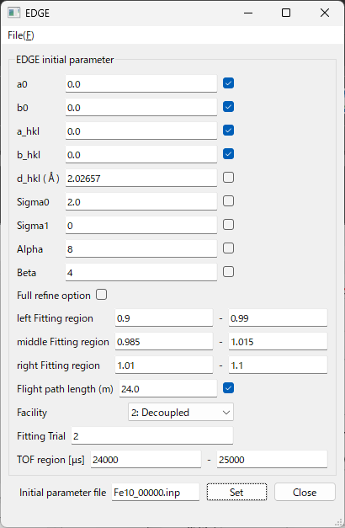
0.9 – 1.1
The lattice constant of this sample has been determined to be 2.8660 Å.
Example of ‘24 m detector position’ of BL22
24000 – 25000
When the initial value file is read (Fe10_00000.inp in this example), the values and the flags are entered.
After confirming the input values, be sure to press the "Set" button.
If you forget to press the button, the program will be executed with the values and flags as they were before the update.
There are two ways to specify the analysis area, but basically the narrower area is adopted. In the present case, the "TOF region [µs]" range is adpted.
Conversely, you can limit it by “left Fitting region" and “right Fitting region", but these tof moves on its own in conjunction with the value of d_hkl during analysis (not recommended).

Slide 7
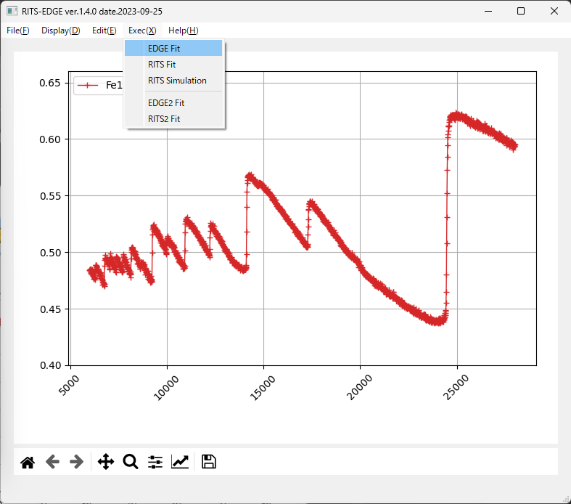
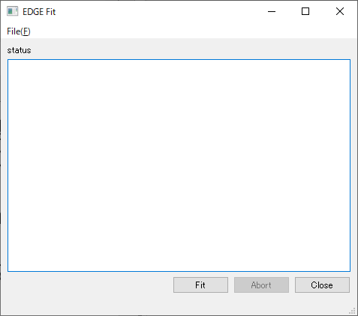
①
②
Select EDGE Fit from the Exec(X) menu on the main screen, and the EDGE Fit panel will appear.
If you did not forget to press the "Set" button on the EDGE panel, press the "Fit" button on the EDGE Fit panel.
③

Slide 8
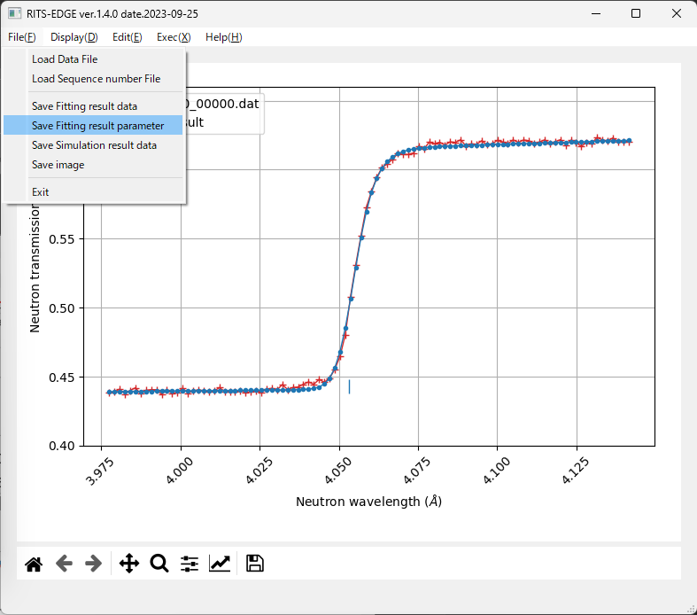
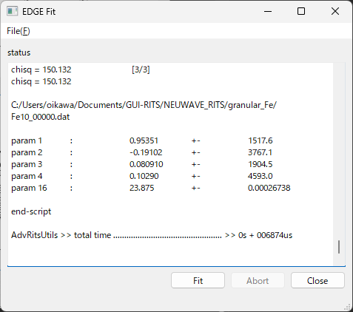
If this is selected, fitting data can be saved as text.
param 1 ~ 4
If you select this, you can save the main screen as a PNG file.
param 16
The analysis is completed in an instant, and the analysis results appear in the EDGE Fit panel.
Select "Save Fitting result parameter" from the File(F) menu on the main screen to open the Windows Explorer window, and save the result parameters with an appropriate file name.
The EDGE initial value file is also saved from "Save initial Parameter" in the File menu of the panel.
Note that the initial file is not automatically updated.
χ²

Slide 9
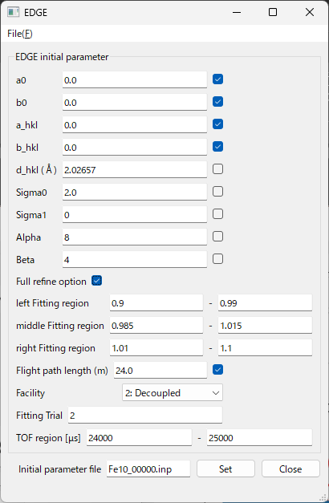
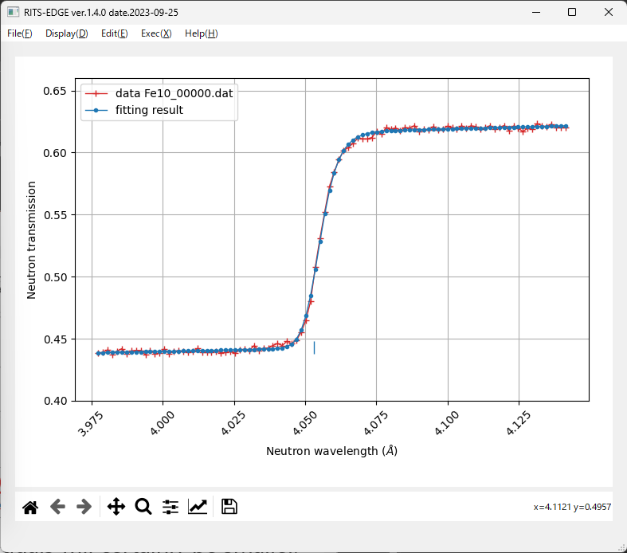
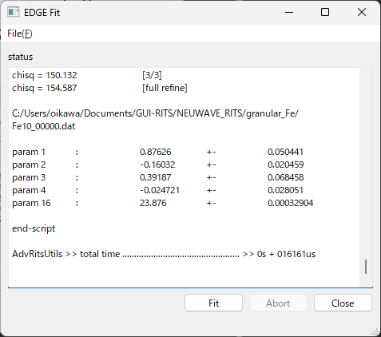
param 1 ~ 4
Full refine option “on”
Full refine option “on”
Try to “on”
param 16
Residuals will certainly be smaller, but it is necessary to carefully determine if the results are correct.
Full refine option “off” and “on”
right Fitting region
↓
left Fitting region
↓
middle Fitting region
↓
all region
Full refine option “off” case
Full refine option “on” case

Slide 10
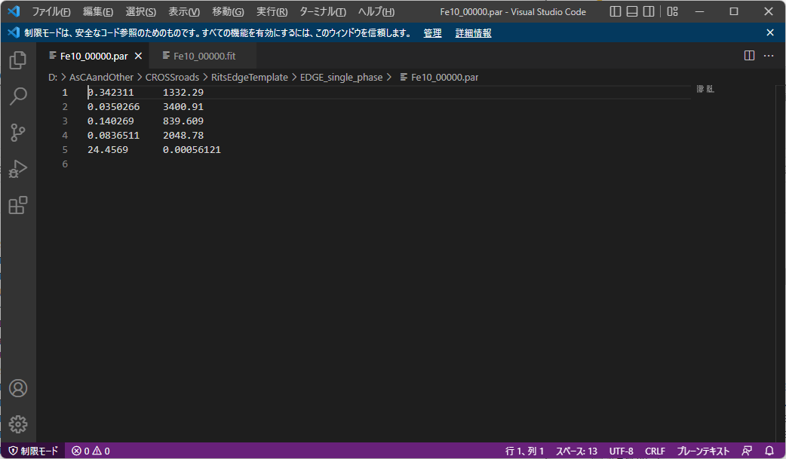
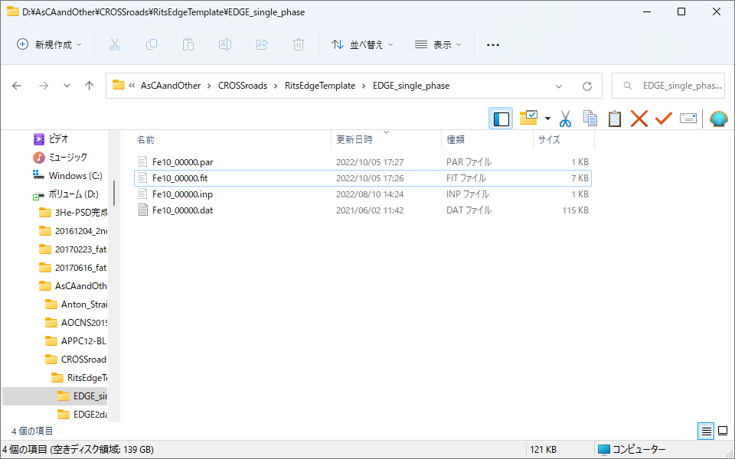
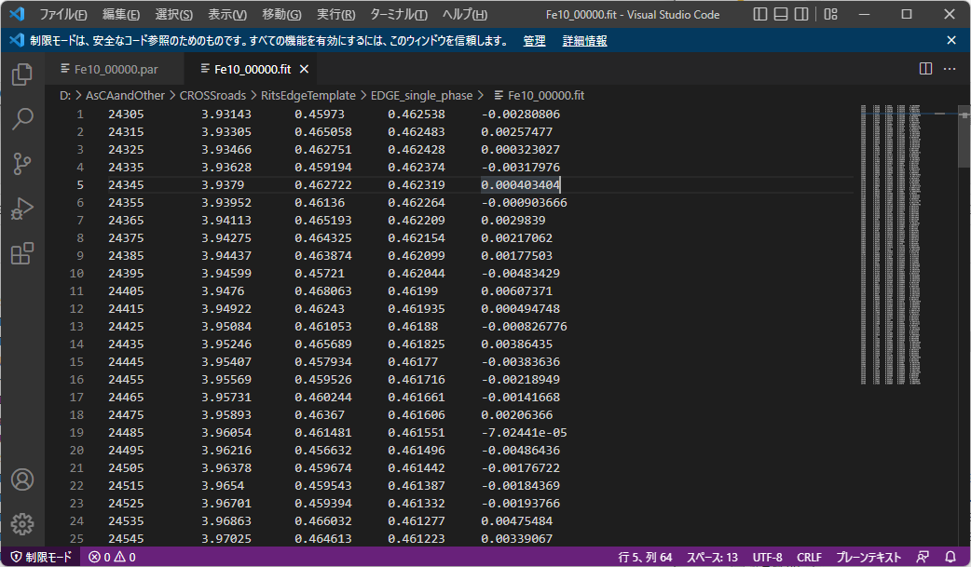
File contents by “Save Fitting result parameter”.
File contents by “Save Fitting result data”.
χ²
Notes:
先程のエッジ解析で得られたパラメータの収束値と、フィッティングパターンのデータを保存すると、このようなファイルになっています。

Slide 11
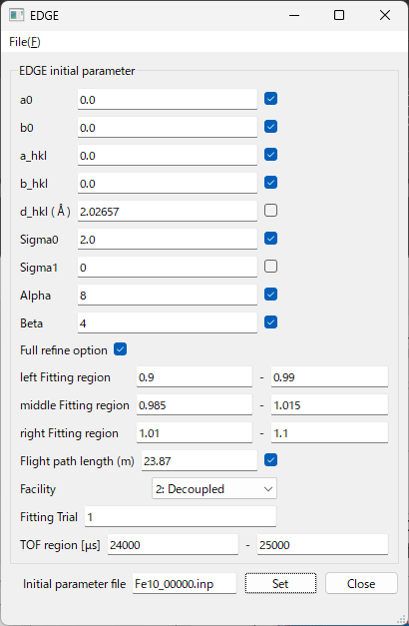
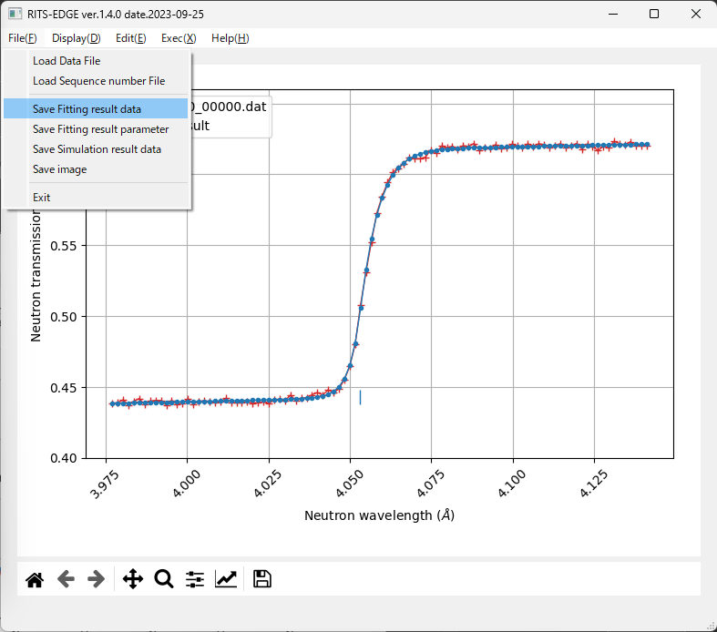
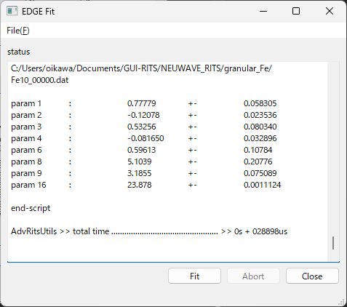
param 1 ~ 4
param 6,8,9
Mainly due to the refinement of Beta
Mainly due to the refinement of Alpha
param 16
(changed)
Next, with the intention of proceeding with the analysis, let's add the refinement flag.
The result of the Fit calculation with the initial values set is shown in the main screen, and the calculation results are displayed in the EDGE Fit panel.
The value of χ² has dropped from about 155 to about 112, but is this result "correct"? Save the data with Save Fitting result data and carefully check.

Slide 12
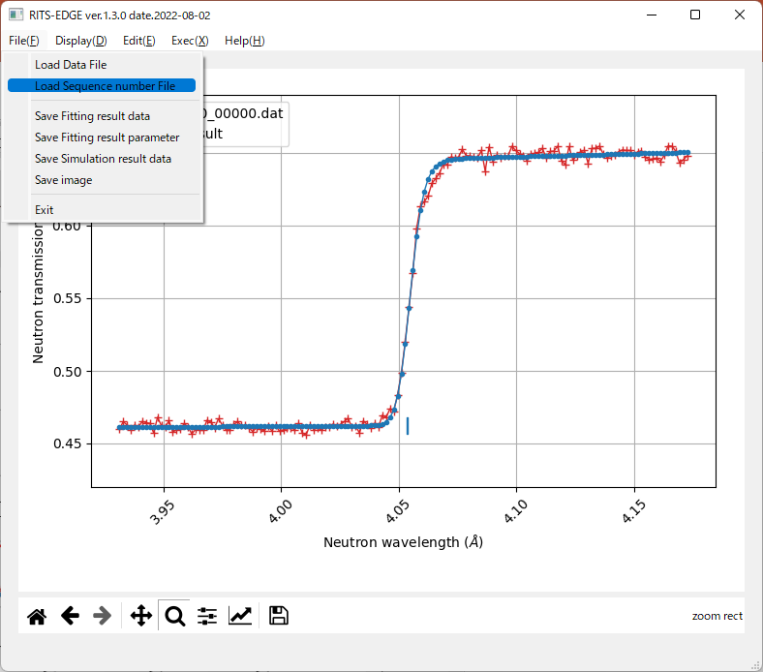
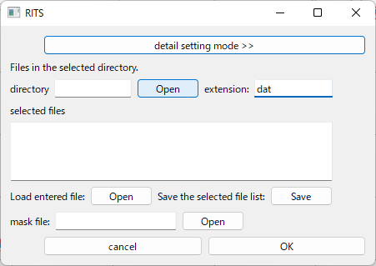
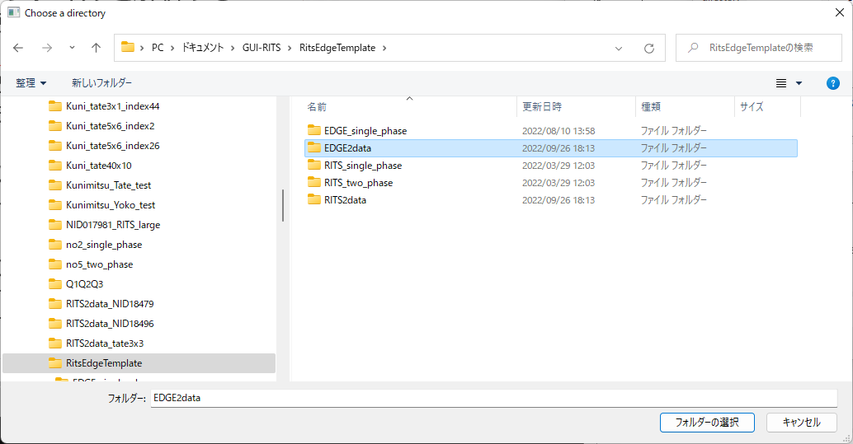
Next, how to use EDGE2 program. let’s select a data folder that contains sequence number file of the transmission data.
Select "Load Sequence number File" from the File menu.
The Windows Explorer screen will appear, and select the folder (in this example, EDGE2data) with a extension: dat.

Slide 13
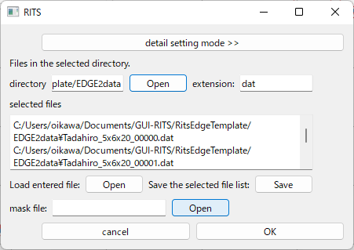
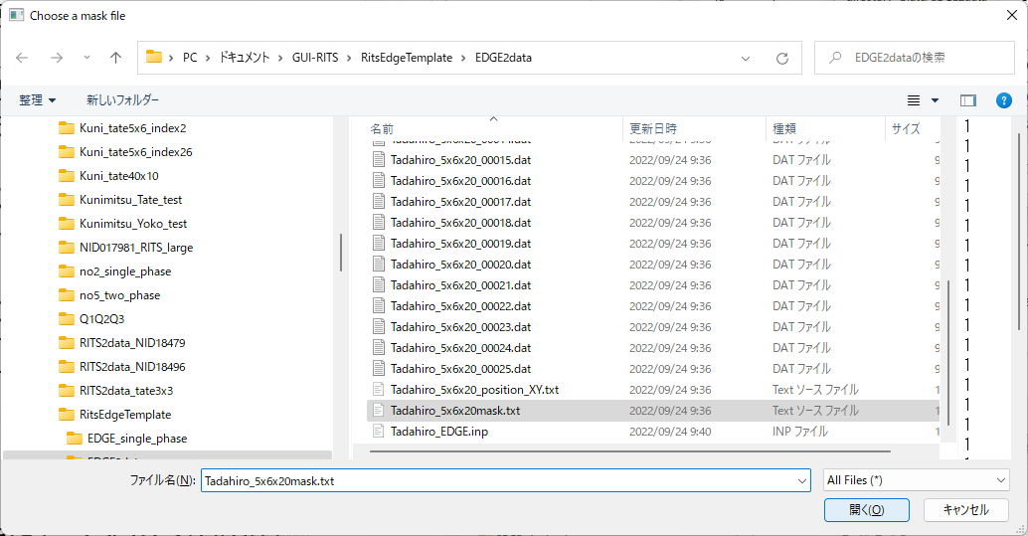
Next, select the mask file.
Select "Tadahiro_5x6x20mask.txt" in the "EDGE2data" folder.
(Actually, the contents of this mask file are all 1, so it works the same without selection.)
Notes:
ポインターをあまり頻繁に動かすな。

Slide 14
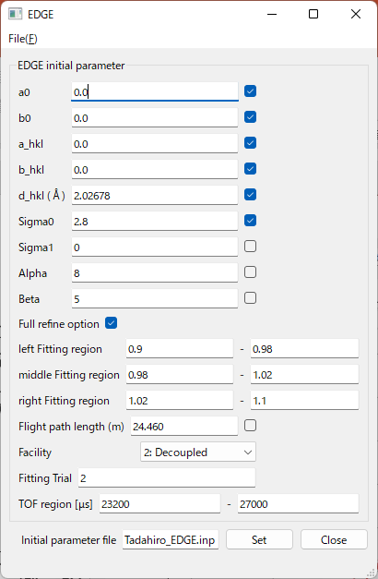
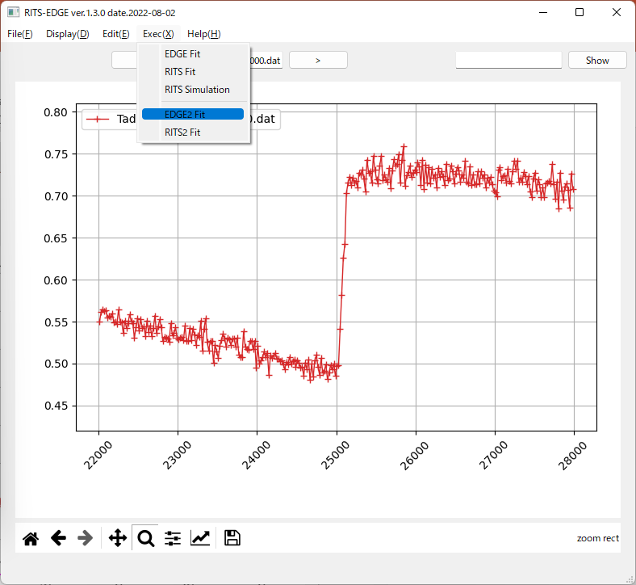
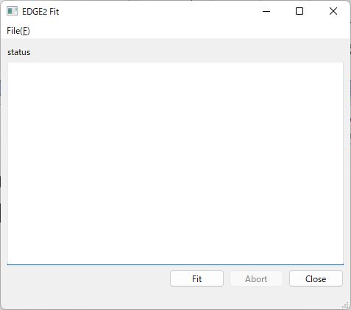
①
23200 – 27000
②
By selecting "Load Initial Parameter" from the File menu of the EDGE panel, the Windows Explorer screen will appear. Select “Tadahiro_EDGE.inp” from the “EDGE2data” folder.
Select EDGE2 Fit from the Exec(X) menu on the main screen, and the EDGE2 Fit panel will appear.
If you did not forget to press the "Set" button on the EDGE panel, press the "Fit" button on the EDGE Fit panel.
③

Slide 15
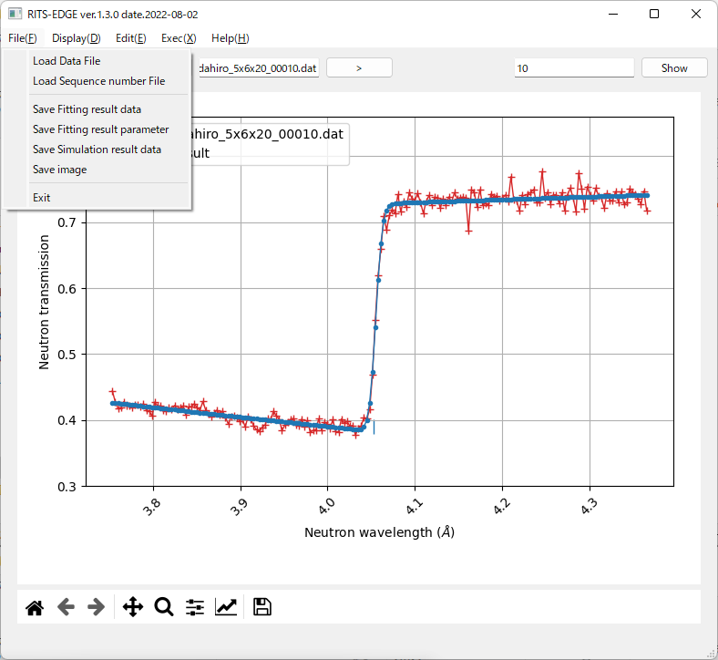
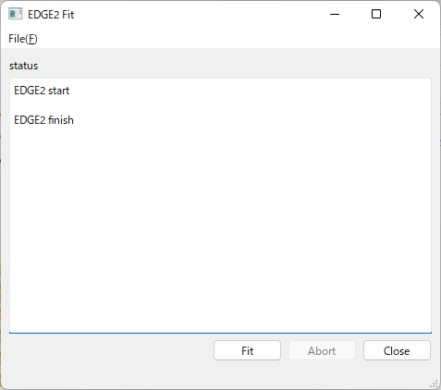
If you select “Save Fitting result data”, you can save the displayed fitting data as text.
The calculation results can be saved with an appropriate file name by selecting "Save Fitting result parameter" in the File menu on the main screen, which will bring up the Windows Explorer screen.
Example of Result parameter
a0, b0, a_hkl, b_hkl, d_hkl, sigma0,
b0_err, b_hkl_err, sigma0_err,
a0_err, a_hkl_err, d_hkl_err, χ²

Slide 16
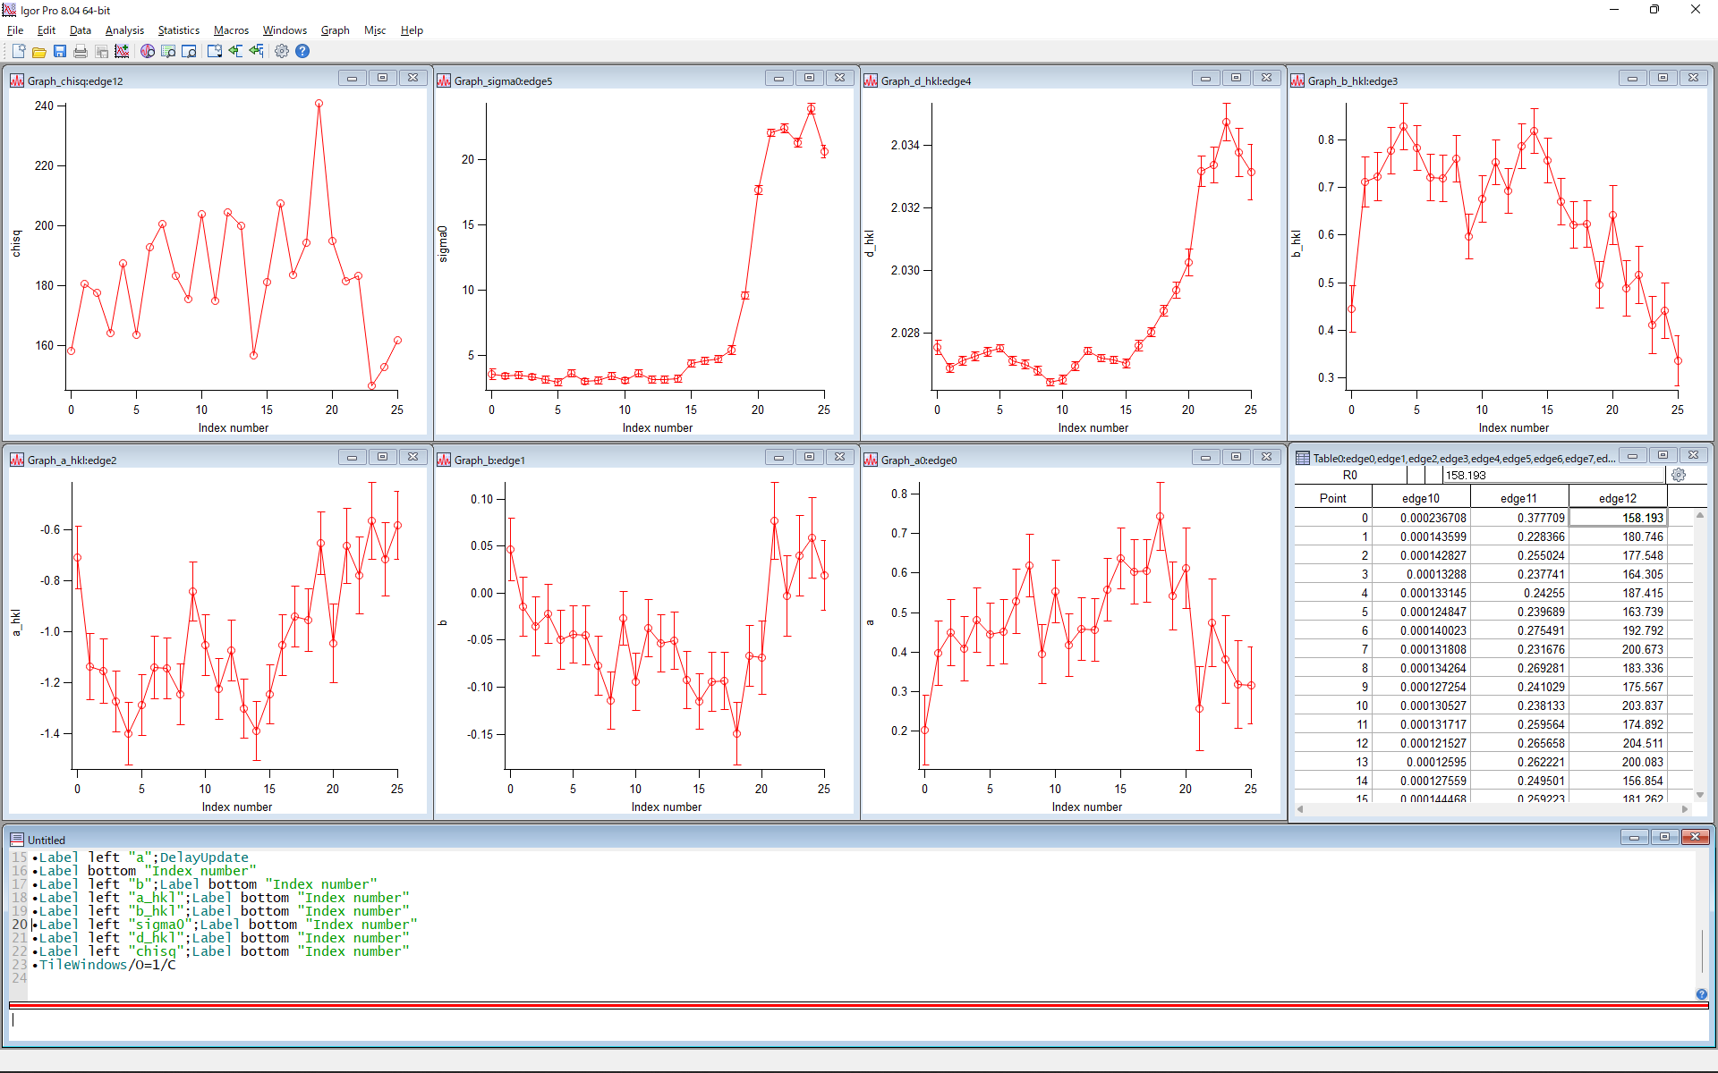
χ²
sigma0
d_hkl
b_hkl
a_hkl
b0
a0
Plot the Result parameter in Igor Pro.

